Slide 1
Director’s Report
73rd Meeting of the
National Advisory Council on
Minority Health and Health Disparities
August 31, 2026
Monica Webb Hooper, Ph.D.
Acting Director
National Institute on
Minority Health and Health Disparities
Monica.Hooper@nih.gov
Notes:
Monica.Hooper@nih.gov

Slide 2
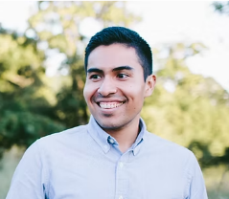
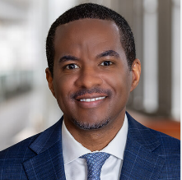
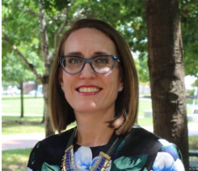
Welcome New NACMHD Council Members
Miguel Marino, PhD
Oregon Health and Science University
Ezemenari M. Obasi, PhD Wayne State University
Johnelle Sparks, PhD University of Texas at San Antonio

Slide 3

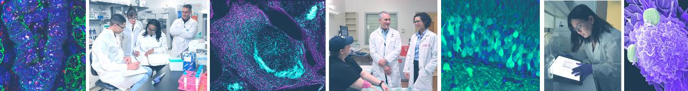


NIH
Updates

Slide 4

White House Appoints New CDC Director
Erica G. Schwartz, MD sworn in as new Director of the Centers for Disease Control (CDC) on Aug. 5, 2026
Previously served as the US Deputy Surgeon General with the rank of rear admiral in the US Public Health Service Commissioned Corps
Dr. Jay Bhattacharya has returned full time as NIH Director

Slide 5
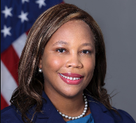


NIH Institute and Center Director Appointments (1 of 2)
Courtney F. Aklin, PhD
Director
National Institute of Nursing Research (NINR)
Raymond Jacobson, PhD
Director
Center for Scientific Review (CSR)
Steven Schiff, MD, PhD
Director
Fogarty International Center (FIC)

Slide 6
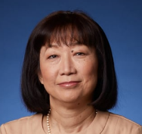
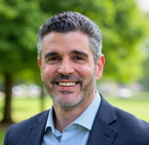
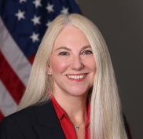
NIH Institute and Center Director Appointments (2 of 2)
Judy H. Cho, MD
Director
National Human Genome
Research Institute (NHGRI)
John Gaitanis, MD
Director
Eunice Kennedy Shriver National Institute of Child Health and Human Development (NICHD)
Wendy Weber, ND, PhD
Director
National Center for Complementary and Integrative Health (NCCIH)

Slide 7
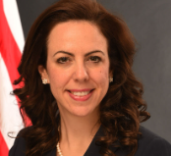
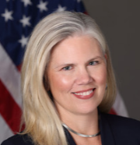
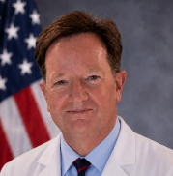
NIH Institute and Center Deputy Director Appointments
Dorothy Fink, MD
Principal Deputy Director
National Institute of Child Health and Human Development (NICHD)
Amy Adams, PhD
Principal Deputy Director
Acting Director
National Institute Neurological Disorders and Stroke
John H. Powers III, MD
Principal Deputy Director
Acting Director
National Institute for Allergy and Infectious Diseases (NIAID)

Slide 8


NIH Launches New Office to Advance Human-Based Research
NIH created the Office of Research Innovation, Validation, and Application (ORIVA) within NIH Office of the Director
Goal is to speed development of human-based research technologies and reduce animal use
ORIVA will coordinate NIH-wide efforts to develop, validate and scale New Approach Methodologies (NAMs)
Warren Casey, PhD, DABT
Director
ORIVA

Slide 9

Launch of the Bio Genesis Mission
On July 22, 2026, the Administration announced partnerships in the Genesis Mission, a national effort to harness AI and advanced computing to support American science.
The NIH-led Bio Genesis Mission strives to double the pace of biomedical innovation within the next five to ten years.
Focus areas:
  Predicting behavior or living systems
  Scaling American biomanufacturing
  Detecting biological threats
  Unlocking cures for pediatric cancers through AI
  Accelerating drug discovery and clinical translation
  Understanding the root causes of chronic disease
  NIH is actively invested in these priority areas; $1.2 billion in FY26 and FY27
Notes:
Bio Genesis Mission https://www.nih.gov/bio-genesismission

Slide 10
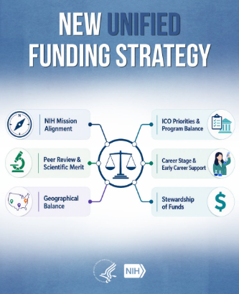
A Conversation About NIH’s Unified Funding Strategy
On Aug. 14, 2026, NIH invited the extramural community to join in a conversation with NIH leadership on the NIH Unified Funding Strategy.
The Unified Funding Strategy is designed to support NIH ICs to make informed, transparent and flexible funding decisions
During the conversation, NIH leadership:
  Clarified the rationale, goals and implementation
  Addressed misconceptions
  Fostered communication between NIH staff and research community
  A recording of the discussion can be viewed on NIH Videocast
Notes:
Unified Funding Strategy https://grants.nih.gov/sites/default/files/Leveraging-Funding-Policies-Framework.pdf
NIH Videocast https://videocast.nih.gov/watch/239b35f0-7181-11f1-82c0-124f0a52e769

Slide 11
Proposed Changes to Reporting Peer Review Outcomes
NOT-OD-26-088: NIH is seeking public comment on proposed changes to reporting of peer review outcomes
Proposed changes are intended to strengthen alignment with the NIH Unified Funding Strategy
Key proposed updates:
  Applications will be placed in three overall impact categories [Most competitive (top 25%), Competitive (26%-50%) or Not Discussed]
  Numerical scoring will not be released to applicants, council members or IC staff
  Comments will be accepted electronically until October 13, 2026
Notes:
NOT-OD-26-088 https://grants.nih.gov/grants/guide/notice-files/NOT-OD-26-088.html
NIH Unified Funding Strategy https://grants.nih.gov/news-events/nih-extramural-nexus-news/2025/11/implementing-a-unified-nih-funding-strategy-to-guide-consistent-and-clearer-award-decisions
Electronically https://rfi.grants.nih.gov/?s=6a2b1c22c3fcfda46e0badd2

Slide 12
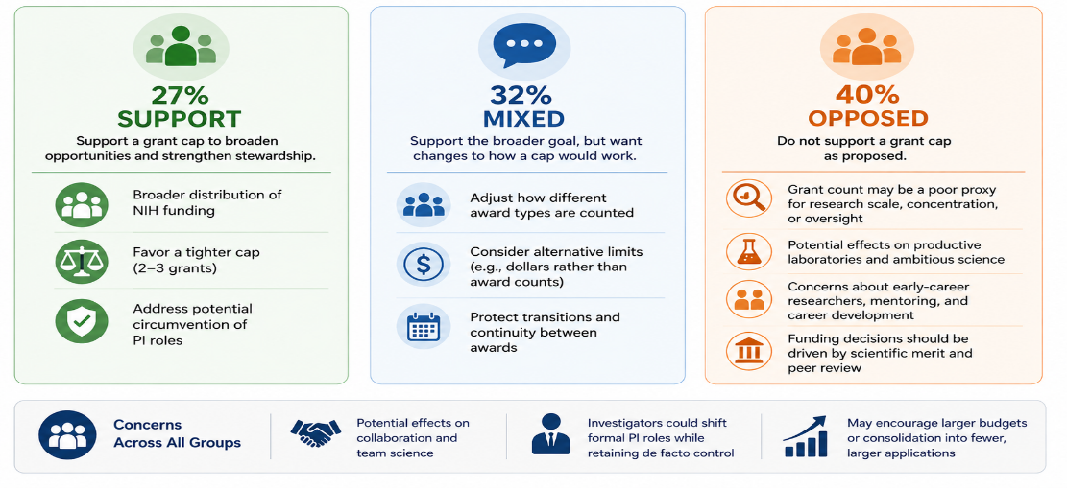
Feedback Received on Proposed Cap on NIH Research Project Grants
NIH Extramural Nexus: Aug 19, 2026

Slide 13
Simplifying the Landscape of NIH Career Development Awards
NOT-OD-26-098: NIH is updating its Career Development (K) Award Programs
Goal is to improve consistency, reduce administrative burden and align policies across K mechanisms
Updated framework:
  Consolidation of K NOFOs
  Data Management Sharing Plans no longer required
  Independent clinical trials no longer supported by Ks
New Activity Code | New Award Name | Current Activity Codes
KR1 | Mentored Research Scientist Career Development Award | K01, K21, K25, K32
KC1 | Mentored Clinician Scientist Career Development Award | K08, K23, K38
KS1 | Investigator Award to Support Mentoring of Early Career Clinician Scientists | K02, K07, K18, K24, K26
KT1/R00 | NIH Career Transition to Research Independence Award | K99, K22
Notes:
NOT-OD-26-098 https://grants.nih.gov/grants/guide/notice-files/NOT-OD-26-098.html

Slide 14
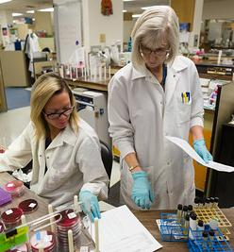
Input Sought on Support for Future Clinical Trial Investigators
  NOT-OD-26-095: NIH is seeking public comment on potential funding models to allow K recipients to serve as PIs for clinical trials through a separate funding mechanism
  NIH recognizes that serving as the PI of a clinical trial can be an important step toward research independence
  Two proposed approaches
    1) Mentored K award plus Limited Competition Clinical Trial Research Project Grant
    2) Phased Transitional Award (Mentored phase followed by independent research project grant)
  Comments accepted electronically until Sept. 30, 2026
Notes:
NOT-OD-26-095 https://grants.nih.gov/grants/guide/notice-files/NOT-OD-26-095.html
Electronically https://rfi.grants.nih.gov/?s=6a57b31c69fc50193d0eb712

Slide 15

Learn About NIH Grants and Funding Through NIH Innovates Social Channels
As part of NIH’s efforts to modernize its web presence, NIH social media accounts have transitioned to @NIH_Innovates on X and LinkedIn
@NIH_Innovates provides centralized, timely updates on grants policies, Highlighted Topics and funding opportunities
Follow @NIH_Innovates and subscribe to NIH Extramural Nexus for the latest news on grants policies, processes and more.
Notes:
NIH Extramural Nexus https://grants.nih.gov/news-events/nih-extramural-nexus-news

Slide 16
Implementing SimplerNOFO at NIH
NIH released its first Notice of Funding Opportunity (NOFO) under the HHS SimplerNOFO initiative (PAR-27-032)
  Department-wide effort to reduce administrative burden and improve accessibility for applicants
SimplerNOFO initiative
  Standardized structure
  Plain language and reduced jargon
  Shorter, more focused
  Easier identification of requirements
  NIH plans to expand this approach to additional funding opportunities over time.
Notes:
SimplerNOFO initiative https://simplergrants.hhs.gov/simplernofos/overview
PAR-27-032 https://files.simpler.grants.gov/opportunities/9a4aeb2f-d0ac-403b-ac67-9d1fd24d9556/attachments/2037e87d-aae5-4621-8e37-b3fb158c3c26/PAR-27-032-Full-Announcement.pdf
SimplerNOFO initiative https://simplergrants.hhs.gov/simplernofos/overview

Slide 17
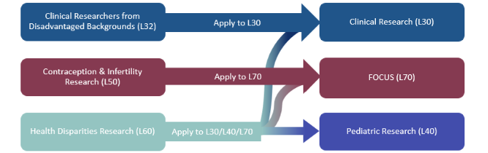
NIH Extramural Loan Repayment Programs: Simplified Structure
NIH Loan Repayment Programs (LRPs) serve to recruit and retain health professionals into biomedical or biobehavioral research careers.
To reduce administrative burden, the LRP program is now streamlined from six to three subcategories
L60 Health Disparities Research applicants will now choose from the three subcategories, including the new FOCUS (L70)

Slide 18

NIMHD Updates:
Webinars, Workshops, Dissemination Activities

Slide 19

Virtual NIH Seminar: Food is Medicine
Register at https://scgcorp.zoom.us/webinar/register/WN_Meb8JLFMT2ueMy4V7qemOA
Notes:
https://scgcorp.zoom.us/webinar/register/WN_Meb8JLFMT2ueMy4V7qemOA

Slide 20
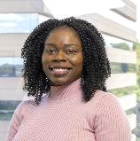
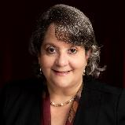
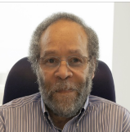
“Shaping the Next Era of NIMHD Science” Webinar
June 22, 2026
NIMHD leadership provided updates on the NIMHD vision for health disparities science, emerging research opportunities to address health disparities and improve population health, as well as current scientific priorities
Over 1000 attendees
The webinar is available for viewing via NIH Videocast
Dr. Monica Webb Hooper
Acting Director, NIMHD
Dr. Larissa Avilés-Santa
Director, Division of Clinical and Health Services Research
Dr. Nathaniel Stinson
Director, Division of Community Health and Population Science
Notes:
NIH Videocast https://videocast.nih.gov/watch/dacc12d3-6f0f-11f1-82c0-124f0a52e769

Slide 21
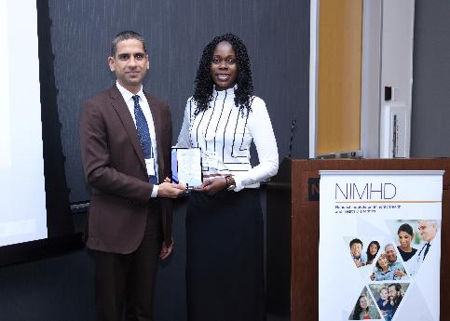
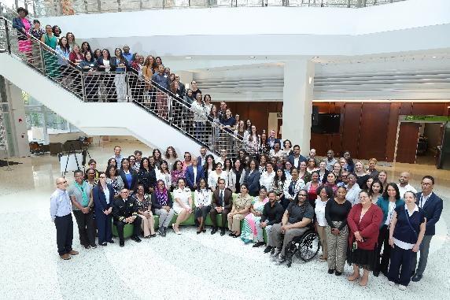
2026 Health Disparities Research Institute
August 3-7, 2026
Participants: 86 early-stage career scientists representing 30 states, plus DC and Puerto Rico
Dr. Sagar Dugani was the recipient of the 2026 NIMHD Early Career Investigator Award
Studies how rural residence, ethnicity, lifestyle, socioeconomic status, and access to care shape diabetes risk and outcomes

Slide 22
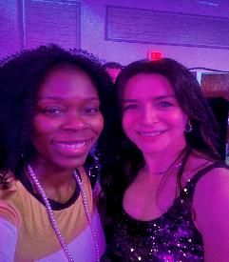



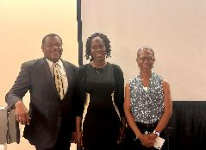
NIMHD Leadership Events and Engagement
May
GLOBAL Down Syndrome Foundation AcceptAbility Gala
Reimagining Clinical Trials: Expanding Access by Meeting Patients Where They Are
American Society of Nephrology
July
RCMI Annual Conference
Lunch and Learn on Rural Health
Latino Health Advocacy (OLHA)
August
American Psychological Association (APA) Annual Convention

Slide 23
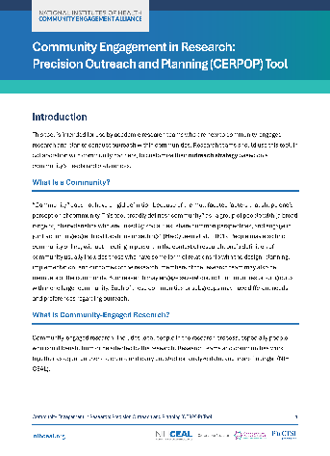
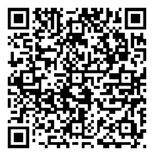
Community Engagement in Research: Precision Outreach and Planning (CERPOP) Tool
Description/Origin of Product:
CEACR developed the CERPOP Tool to help community-engaged researchers plan more community-centered outreach and overcome challenges with outreach planning.
Tool is an element of helping research teams to "engage to partner"
Product Utility:
Guides researchers to systematically develop tailored, community-centered outreach strategies
Academic researchers' complete tool with community partners, facilitating community-academic collaboration
Now Available Online via Free Download
https://nihceal.org/resources/ceacr-precision-outreach-and-planning-cerpop-tool
Notes:
https://nihceal.org/resources/ceacr-precision-outreach-and-planning-cerpop-tool

Slide 24
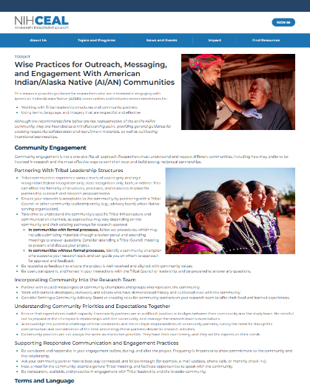
Wise Practices Toolkit for Engagement with
American Indian/Alaska Native (AI/AN) Communities
This resource provides guidance for researchers who are interested in engaging with American Indian/Alaska Native (AI/AN) communities and includes recommendations for:
  Working with Tribal leadership structures and community partners
  Using terms, language, and imagery that are respectful and effective
https://nihceal.org/resources/ceacr-wise-practices
Notes:
https://nihceal.org/resources/ceacr-wise-practices

Slide 25

NIMHD Updates:
Extramural Scientific Areas and Considerations

Slide 26

NIMHD Highlighted Topics
Highlighted Topics represent selected research priority areas within one or more NIH Institutes, Centers, or Offices (ICOs).
NIMHD is currently participating in 13 different Highlighted Topics
NIMHD is the lead ICO for the new topic: Advancing Data Science Approaches to Address Health Disparities Through Artificial Intelligence (AI), and Machine Learning (ML), and Community-Engaged Research
Apply through an appropriate funding opportunity, such as NIH Parent Funding Announcement or other broad NIH opportunities.
Notes:
Highlighted Topics - https://grants.nih.gov/funding/find-a-fit-for-your-research/highlighted-topics
Advancing Data Science Approaches to Address Health Disparities Through Artificial Intelligence (AI), and Machine Learning (ML), and Community-Engaged Research - https://grants.nih.gov/funding/find-a-fit-for-your-research/highlighted-topics/112
NIH Parent Funding Announcement - https://grants.nih.gov/funding/explore-nih-opportunities/parent-announcements

Slide 27

NIMHD Priorities: Where the Science Is Going
Mechanism-focused research to explain observed differences in health outcomes
Studies spanning biologic, behavioral, clinical, environmental, and health care factors
Life-course research on early exposures, cumulative burden, and aging
Intervention development, testing, and refinement
Implementation research to improve reach, uptake, fidelity, and sustainability
Advances in measurement, methods, and data science
Discovery → Mechanism → Intervention → Implementation → Population impact

Slide 28
High-Priority Substantive Areas
Cancer prevention, screening, treatment, and survivorship
Cardiovascular disease, hypertension, stroke, and cardiometabolic risk
Diabetes, obesity, and related chronic conditions
Maternal health, infant outcomes, and reproductive health
Mental health, substance use, and behavioral health services
Aging, multimorbidity, cognitive health, and functional outcomes
Availability of care, quality of care, and continuity of care

Slide 29
NIMHD Initiative Highlights
Research Centers in Minority Institutions (RCMI): strengthens research capacity, infrastructure, collaboration, and investigator development.
Native American Cancer Outcomes Initiative: supports research to improve understanding of cancer burden, care, and outcomes in Native populations.
Native Hawaiian and Pacific Islander Health Research Office: advances research attention, coordination, and visibility for Native Hawaiian and Pacific Islander health.
SBIR/STTR: supports small business innovation, including diagnostics, devices, digital tools, and implementation solutions.
HIV science: includes prevention, testing, treatment continuity, comorbidities, aging, and outcomes across the HIV care continuum.

Slide 30

Native Hawaiian and Pacific Islander
Health Research Office
Goals:
  Address Native Hawaiian and Pacific Islander (NHPI) health disparities
  Support the development and training for researchers focused on NHPI health
  Develop partnerships with academic institutions with a demonstrated track record of working closely with NHPI communities and NHPI-serving organizations
Regular Activities:
Attend and present at various conferences
Meet with NHPI-focused grantees visiting NIH, various community-based organizations, and NHPI-focused program staff at NIH
Participate in CEAL’s Asian American and NHPI Interest Group

Slide 31

NHPI Health Research Office – CEAL Collaboration
Native Hawaiian and Pacific Islander Community-Academic Partnership (NHPI CAP)
  “Partnering with the Pacific Community of Alaska to Support Maternal Health”
  University of Alaska, Fairbanks
  MPIs: Katie Cueva, PhD and Tafilisaunoa Toleafoa
  “Pacific Wellness Together”
  University of California, Los Angeles
  MPIs: Ninez Ponce, PhD, MPP, Ualani Ho’opai, MPH, and Mona AuYoung, PhD, MS, MPH
  “Strengthening Health Literacy and Provider–Community Communication to Improve Cardiovascular Health in American Samoa and the CNMI”
  University of North Texas
  MPIs: Jamboor K. Vishwanatha, Ph.D, Linda Perna, Ph.D., Va'atausili Tofaeono, PhD, MBA, Jessica Willsey

Slide 32

NIMHD Updates:
Division of Intramural Research

Slide 33
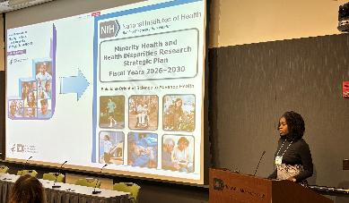
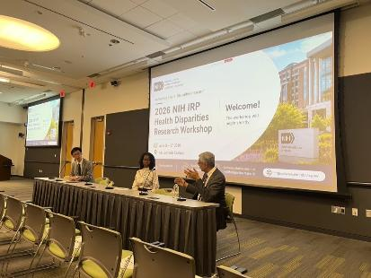
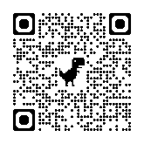
Fostering Collaboration within the NIH Intramural Research Program for Solution-Oriented Research
NIMHD hosted the inaugural NIH IRP Health Disparities Research Workshop, June 16–17, 2026, connecting NIH investigators, scientists, trainees, and staff in health disparities research.
The two-day program featured scientific talks, panels, posters, and a Q&A with the NIH Director.
Participants shared research across topics, populations, and methods — sparking new collaboration opportunities across the NIH community.
There are opportunities for collaborations with extramural researchers.
NIMHD Division of Intramural Research
Top: Dr. Webb Hooper gave opening remarks. Bottom: Dr. Bhattacharya, Dr. Webb Hooper, and Dr. Choi discussed the next generation of health disparities research.

Slide 34

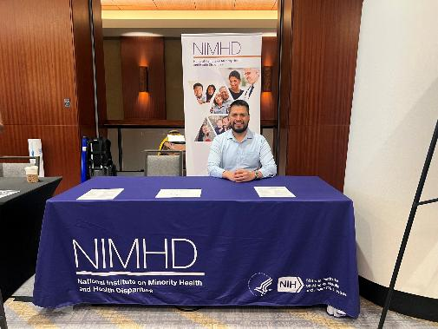
NIMHD at the 2026 Society for Epidemiologic Research (SER) Annual Meeting
NIMHD DIR investigators and fellows attended the 2026 SER Annual Meeting to share their latest research findings.
Presentations covered topics including neighborhood environment, psychological well-being, diabetes, mental health, health behaviors, and secondhand tobacco exposure.
The NIMHD DIR Acting Training Director, Dr. Christian Alvarez (picture) shared information about training opportunities and the DIR training program.

Slide 35

NIMHD Launched Solutions-Oriented Health Disparities Research Innovation Award to Promote Intramural Collaboration
NIMHD DIR launched a new intramural research award to support 2-year research projects involving at least two Institutes or Centers to conduct research that address:
  Clinically actionable conditions
  Biologic, behavioral, and environmental mechanisms
  Early detection and prevention
  Treatment optimization
  Implementation strategies that can improve measurable health outcomes.

Slide 36

NIMHD Solutions-Oriented Health Disparities Research Innovation Award: Recipients
Jayasekera, Roger, and Gierach (NIMHD, NHLBI, NCI/DCEG)
Developing a Simulation Model-Based Clinical Decision Tool to Reduce Disparities in Exercise and Cardiovascular Health among Breast Cancer Survivors
Sinha & Forde (NIDDK & NIMHD)
The Early Tracking of Childhood Health Determinants Postpartum Lifestyle Upgrade Study (ETCHED +Plus)
Camargo, Hong, Kumar, & Klion (NCI/DCEG, NIDDK, NIAID)
Stool Co-testing as a Strategy for Gastrointestinal Cancer Prevention in Low Socioeconomic Populations in Texas - STool cO-testing for Prevention in Texas (STOP-TX)
Ebenuwa & Tamura (NIDDK & NIMHD)
Micronutrient Dysregulation in Diabetes: Nutritional and Socioecological Pathways to Addressing Health Disparities

Slide 37
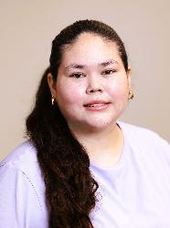
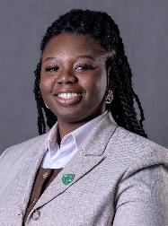
NIMHD Research Interns: 2026 NIH Summer Poster Day
The 2026 NIH Summer Poster day was held on August 6th at Natcher.
Two NIMHD DIR summer interns presented their mentored research after an 8-week internship.
They had the chance to talk about their projects and connect with NIH researchers and other trainees.
Kishay Flansburg (top): Association Between Sugar-Sweetened Beverage Consumption and Short Sleep Duration Among U.S. Adolescents: Findings from the Behavioral Risk and Impact on General health (BRIGHT) Study
Sandra Owusu (bottom): Mental Distress as a Pathway Between Serious Violent Crime and Diabetes: A Longitudinal Analysis and Future Directions

Slide 38
5 Science Advances
Clinical decision aids
Heart failure treatment
Telomere length

Slide 39
Social Needs Informed Decision Support and Blood Pressure Control in Primary Care
Adverse social needs (e.g., food insecurity) make chronic diseases harder to manage
Unclear whether social clinical decision support tools within electronic health records (EHRs) can inform care and improve patient outcomes
  Clinical trial (50 community-based clinics): 12 months in 2023–2024; 79,030 adults, most experiencing poverty
    Blood pressure control improved more when the tool was used (56.0% to 60.3%) though HbA1c did not improve significantly
  The tools increased how often social needs were documented during patient visits (21.3% of intervention visits compared with 8.5% of control visits)
Embedding social needs data into clinical workflows can be used to inform care and may help reduce disparities in chronic disease outcomes.
  Potentially scalable way to incorporate social risk information into chronic disease management in safety-net settings; may help health care teams recognize and respond to them during care.
McGrath, B. et al. [Ann Fam Med] 2026.
Grant No. R01MD014886
Notes:
Ann Fam Med - https://www.annfammed.org/content/24/2/97.long#sec-6

Slide 40
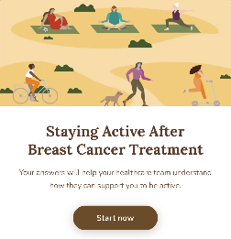
Most Clinicians Found a New Tool for Prescribing Exercise Helpful
    First-of-its-kind clinical tool to help clinicians and breast cancer survivors leverage a teachable moment to promote exercise.
Over 4 million breast cancer survivors live in the US, but fewer than 60% exercise enough to support their recovery — especially those with lower incomes or in rural areas.
Study built and tested a new clinical tool that helps clinicians give survivors personalized exercise plans.
69 healthcare providers and 26 survivors who weren't meeting exercise guidelines tried the tool and gave feedback.
About 9 in 10 providers and survivors found it useful, and roughly 85% said it boosted their confidence to talk about exercise.
  The tool has potential to increase exercise among breast cancer survivors.
Tian E, …, Jayasekera J. JMIR Form Res. 2026.
Grant No. ZIA MD000022
Notes:
JMIR Form Res - https://pmc.ncbi.nlm.nih.gov/articles/PMC1328797

Slide 41
Digital Decision Aid to Improve Lupus Patient Care
  Health disparities in lupus exist by income, education, and race/ethnicity
  Study evaluated the real-world implementation of an evidence-based decision aid among people with systematic lupus erythematosus (SLE)
  1,895 patients (93.3% female, 45.1% Black) across 15 US sites were assigned to use a Full (detailed) or Lite (basic) digital aid to improve SLE disease management
  There were high ratings for patient-provider care, communications and use of the tool; those using the Full version felt significantly more prepared to make treatment choices
  `
Implementing a tailored, digital SLE decision aid is a highly viable, scalable strategy to improve patient-centered lupus disease management and foster clinical communication.
  The decision aid is practical to roll out and highly acceptable for improving lupus disease management
Singh JA, et al.. Lancet Rheumatol. 2026
.
Grant No. R01MD015395
Notes:
Lancet Rheumatol - https://pubmed.ncbi.nlm.nih.gov/40975111/

Slide 42
Polypill Treatment Improved Heart Function in Low-Resource Heart Failure Patients
Heart failure is rising among younger adults in the US. This clinical trial tested a single pill combining multiple heart medications for low-resourced heart failure patients in North Texas.
  N = 212 (median age 54 yo, 22% female, 54% Black, 33% Hispanic, most uninsured or on county health programs)
Randomized to polypill therapy or enhanced usual care.
At 6 months, the polypill group had greater improvement in cardiac function:
  Improved ejection fraction
  60% lower rate of heart failure hospitalizations or emergency department visits.
  Higher medication adherence (polypill, 79% vs. 54%, enhanced usual care).
  Polypill option provided statistically and clinically significant benefits, with potentially far-reaching implications for other polypill regimens for other medical conditions.
This trial showed that a combination pill for heart failure led to significant improvement in cardiac function compared to enhanced usual care, in patients facing socioeconomic or other challenges to treatment
Pandey, A., et al., [Nat Med.]. 2026.
Grant No. R01MD017529
Notes:
Nat Med -

Slide 43
More Unhealthy Food Stores and Higher Population Density Linked to Faster Cellular Aging
Faster cellular aging increases risk for cancer and cardiometabolic disease, especially among Black/African American adults.
Study included 2,174 Black/African American adults in the Jackson Heart Study, using telomere length as a marker of cellular aging.
Black/African American women living in neighborhoods with more unhealthy food stores and higher population density had shorter telomeres.
Findings suggest neighborhood environments may influence biological aging and disease risk.
    Building healthier neighborhoods and targeting health screenings could help prevent and diagnosis chronic diseases earlier.
Grant No. ZIA MD000020
Moniruzzaman M, …, Tamura K. Annals of Behavioral Medicine. 2026
Notes:
Annals of Behavioral Medicine - https://academic.oup.com/abm/article/60/1/kaag016/8658839

Slide 44
Intervention Program to Improve Balance among Older Adults
Falls are a major health risk factor for older adults, often leading to serious injuries, physical limitations and high medical costs
  A study tested an 8-week exercise and coaching program (PEER) with 373 older adults in low-income communities in FL, predominately Black or Hispanic women
  Participants showed some improvement on one component of balance (12% reduction in posture drift) but effects faded after 1 month
Short balance programs help improve balance temporarily; longer duration and continuous
targeted training is needed for sustainable improvements.
  Older adults likely need balance programs with a longer duration and more frequent exercise sessions
Suarez, J.R., et al., Geriatrics. 2026.
Grant No. R01MD018025
Notes:
Geriatrics - https://pmc.ncbi.nlm.nih.gov/articles/PMC12821712/

Slide 45

Thank you!

